Slide 1
Methods To Reset Admin Password

Slide 2
Method 1: With Password Reset Disk
Pros:
1.No external program is needed.
2. If you have a password reset disk, you can change or reset user account passwords.
3. No data is removed from the drive while creating the Password Reset Disk.
Cons:
1. It is less secure. If someone finds the password Reset Disk, they can access your PC without your knowledge.
2. This method is useless in case you did not create a password reset disk before forgetting the password as you need to be logged into a PC to create one.

Slide 3
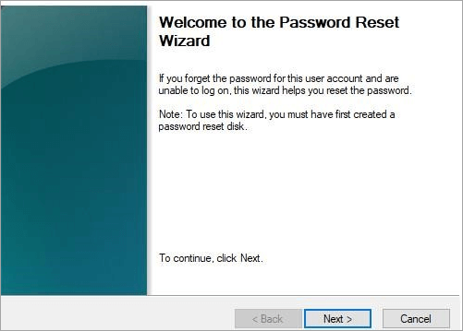
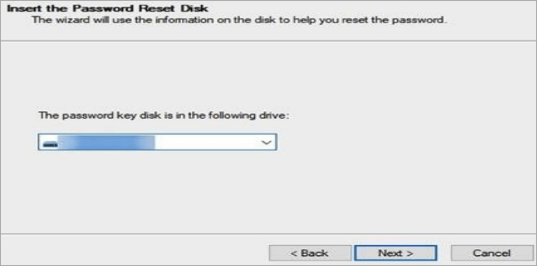
Step 1: Plugin your Password Reset Disk into your computer and reboot your computer.
Step 2: Click the Reset your password link when the login screen appears.
Step 3: Click Next on the following screen.
Step 4: Your computer will ask you to choose your Reset Disk from the drop-down menu. Do so and click on Next.

Slide 4
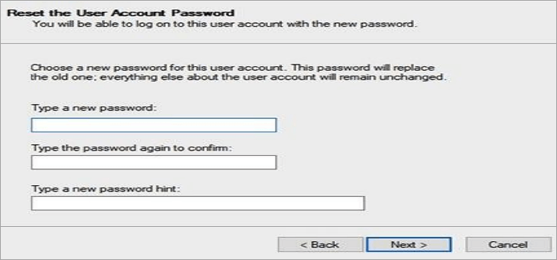
Step 5: The following screen asks you to enter a new password for your account. Hit the Next button after providing a new password for your account.

Slide 5
Method 2: By 4WinKey
The best solution for a non-technical person would be using some tool that has a graphical user interface.
PassFab 4WinKey is a complete package to solve any problems related to user accounts. Due to its attractive and user-friendly interface, it is so easy to use.
Pros:
1. No data loss.
2. User-friendly interface.
3. Simple steps to perform.
4. Can create the Password Reset Disk using any accessible PC.
5. Can manage any type of account, i.e. local or admin.
6. Create/Delete or Reset the passwords on Windows 11/10/8.1/8/7/Vista/XP/2000, and Windows server 2019/2012/2008
7. Supported by all brands of PCs.
Cons:
1. Needs to be purchased to avail of all of its features.
2. Free trial only available from PassFab 4Winkey website.

Slide 6
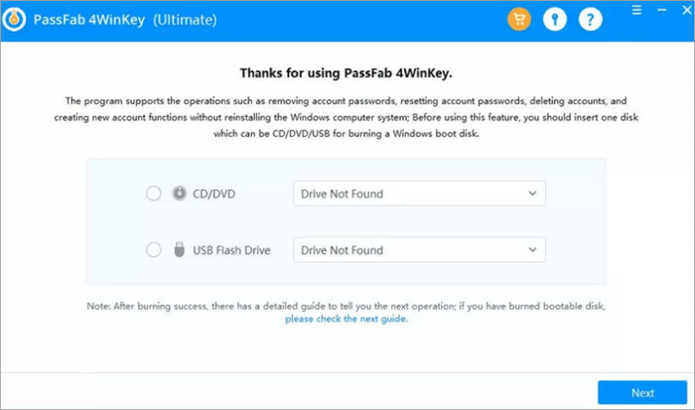
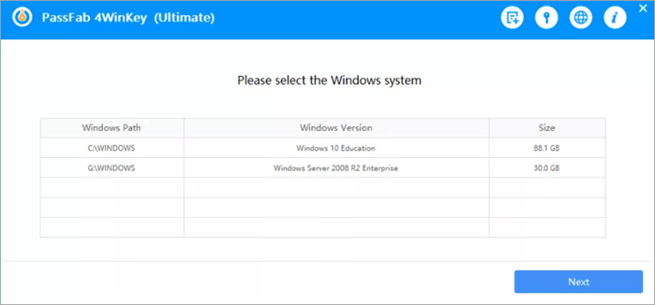
Step1: Download, install and launch PassFab 4WinKey, and choose the boot media —USB /CD /DVD
Step 2: Click on “Next”, and wait for a minute. Once the burning process is complete, eject the media and insert it on your locked computer.
Step 3: Restart the computer and press ”F12” or ‘ESC” to enter the boot menu.
Step 4: In the boot menu, choose your USB/CD/DVD drive and press “enter” to put it. Meantime, choose the Windows system.

Slide 7
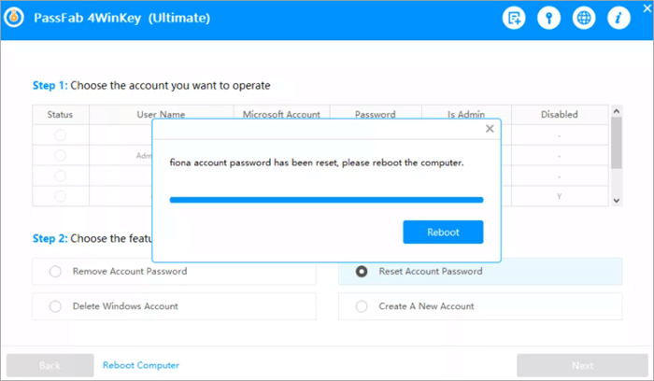
Step 5: Choose the “reset account password” option and reset the password.

Slide 8
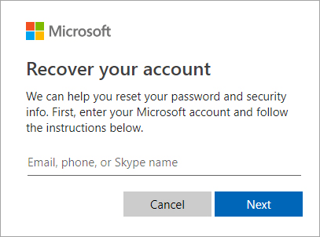
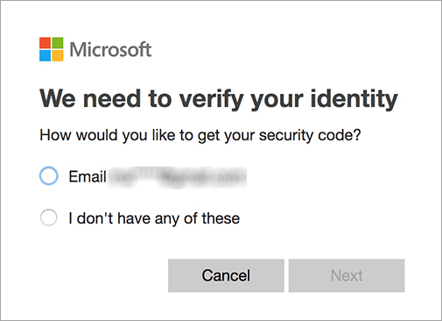
Method 3: With Microsoft Account Online
If you had set the Microsoft Account Online before forgetting the Administrator account password, Bingo! You can reset the admin account password without any password reset disk or installing third-party software.
To follow this method, here are the steps:
Step 1: Open the browser on any accessible PC and go to the lin.
Step 2: Provide your email address or the phone number you set on your locked PC.
Step 3: You will be asked to verify your details.

Slide 9
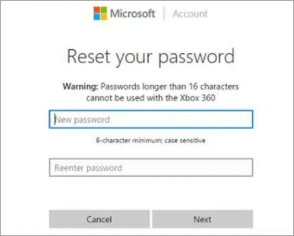
Step 5: Once verified, you will be asked to enter the new password.

Slide 10
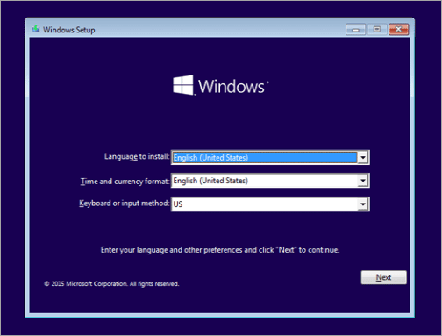
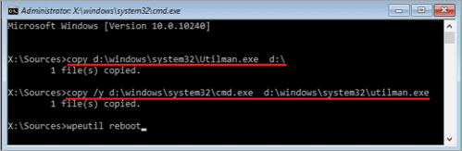
Method 4: Using Command Prompt:
Here are the steps to follow:
Step 1: Start your Windows PC and boot through an installation disk.
Step 2: When you see the following screen, press the Shift + F10 key.
To replace the d:\ drive with the drive name where Windows 10 is installed on your PC.
Step 3: You will see the Command Prompt. Type in the following command and press Enter:
copy d:\windows\system32\Utilman.exe d:\
Step 4: Now, type the following command and again press Enter:
copy /y d:\windows\system32\cmd.exe d:\windows\system32\utilman.exe
Step 5: Type wpeutil reboot and press Enter. Your PC will reboot.

Slide 11
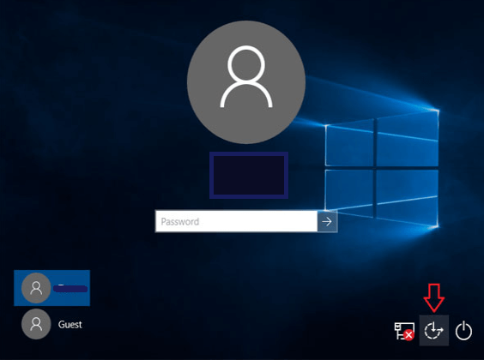
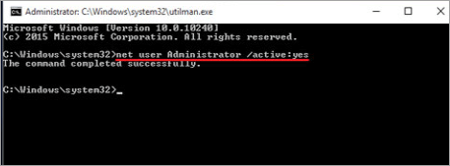
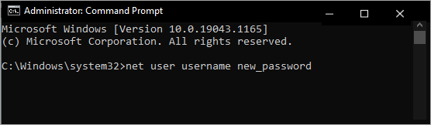
Step 6: When the Windows login screen appears, click on the Ease of Access button at the bottom-right corner of the screen. The Command Prompt window will appear.
Step 7: Now, type net user Administrator /active:yes and press Enter to activate the built-in admin account.
Step 8: Now, type the following command to reset the admin account password:

